Slide 1

StartitUp
Build. Grow. Get Funding.

Slide 2
50,000 (est.) startups are created every month around the world.
But 85%+ of those startups fail…
And not to mention the people who want to start but cannot.

Slide 3

Can’t code. Your problem doesn’t exist. The solution is wrong. Wrong target audience. Can’t get users. Landing page doesn’t convert users. Too many things can go wrong.

Slide 4

What
When
What Else?
This is Josh. He’s stuck.

Slide 5

Startup knowledge is scattered, unorganized, and disorderly.

Slide 6

It’s hard to get users and feedback for your startup.

Slide 7

The Dead Pool

Slide 8

Enter the Ultimate Startup Guide
Knowledge from: Lean Startup, Growth Hacking, SEO, Steve Blank, Eric Ries, Ash Maurya, Noal Kagan, Mattan Griffel, etc.

Slide 9
Action Items to take you from idea, to product, to traction, and to funding.

Slide 10
Get immediate results with step-by-step action items.

Slide 11
Get Feedback from the startup community.

Slide 12
Here’s how you get started

Slide 13
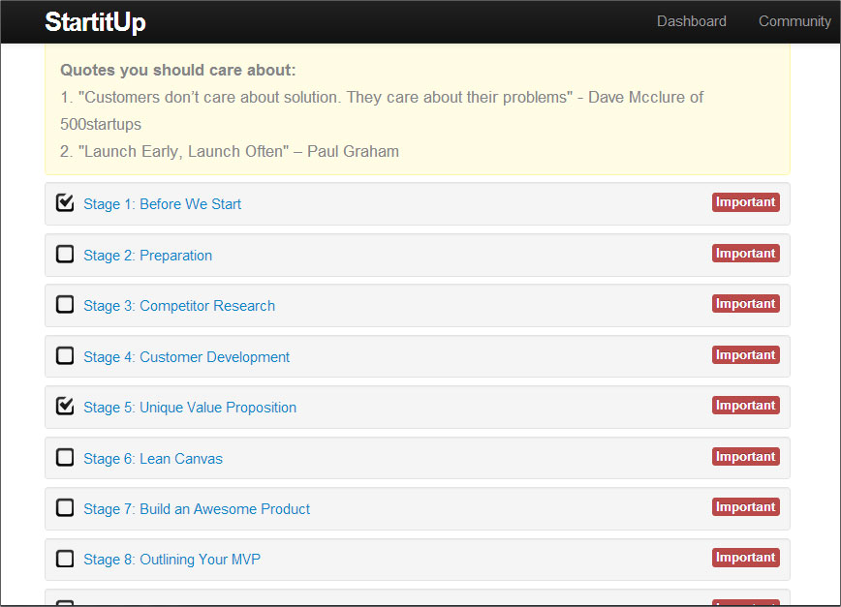

Slide 14
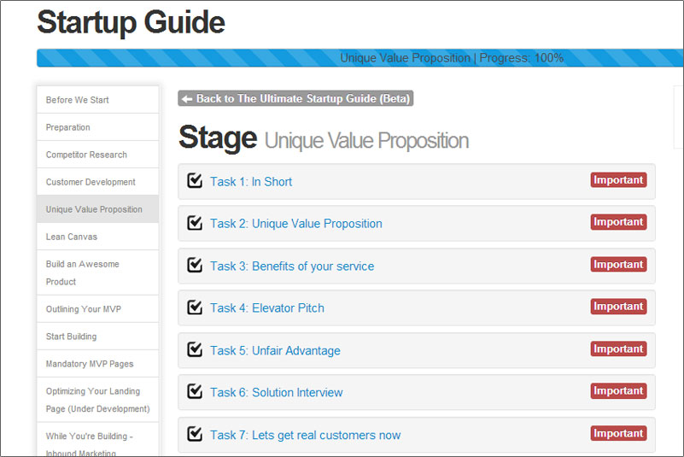

Slide 15
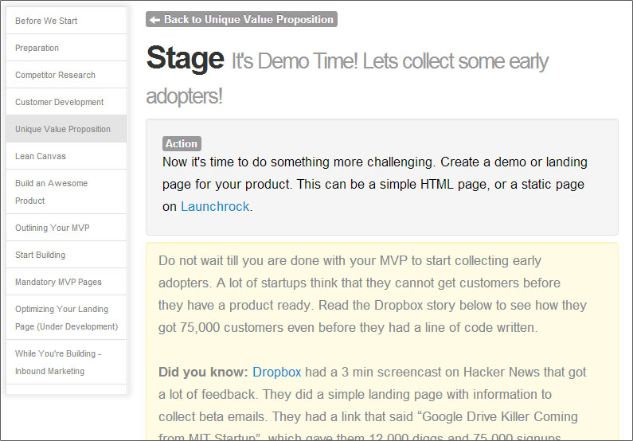

Slide 16
A growth hacking trick like this would give a startup hundreds of users within days.

Slide 17


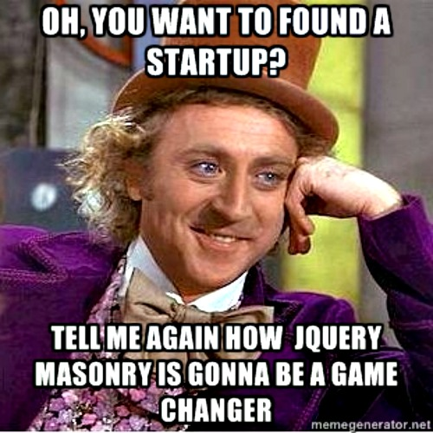
Wantrepreneurs
Have a great idea
Don’t know where to start
Willing to learn

Slide 18
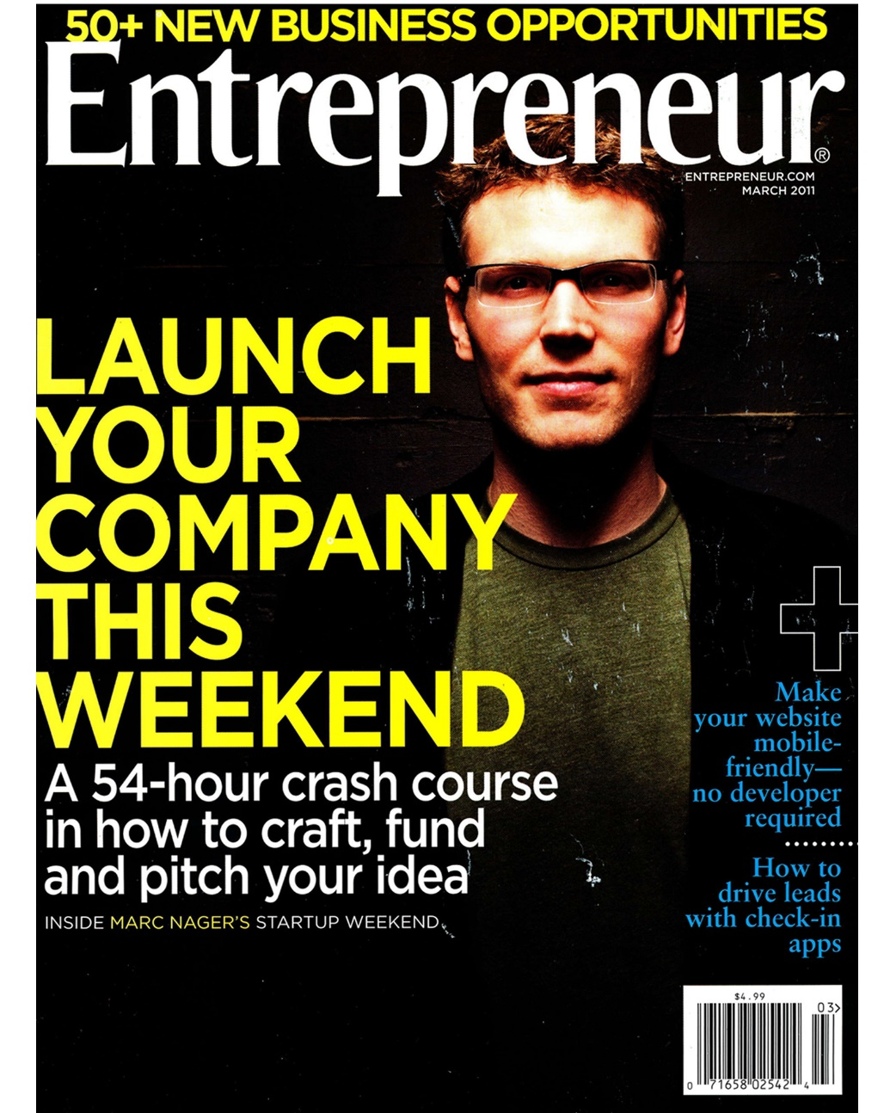
Entrepreneurs
Experienced
Made some progress but stuck
Want to grow

Slide 19









Slide 20
Within 1 month, StartitUp already has 500 active users
Already covered by Tech.co.

Slide 24
How do we make money?

Slide 25
Free:
80% of the guide
Paid:
20% Premium Sections
Validation Service

Slide 26
150,000 Startups in their early phase/month
10% of that market
$15/month
= $225,000/month

Slide 27
Who’s competing with us?

Slide 28

Charges for all the startup plays
Segmented guides, not continual, like selling eBooks in the form of guides
No emphasis on community

Slide 29

Team StartitUp
CEO/Edward Liu
CEO of National Div. @Groupon Taiwan
Swagly.com
CTO/Yitao Sun
Lead Developer @Computer Associates

Slide 30
What’s Next?

Slide 31
10,000 Users
Experts’ Endorsements
$500,000 in funding

Slide 32
StartitUp!
And Thank You!
StartitUp.co
ed@startitup.co

